Slide 1


Slide 2
Today’s presentation
Introduction-Context-Rationale
Trends and Challenges
Planning Framework and Vision
Key Themes of the Plan
Next steps

Slide 3
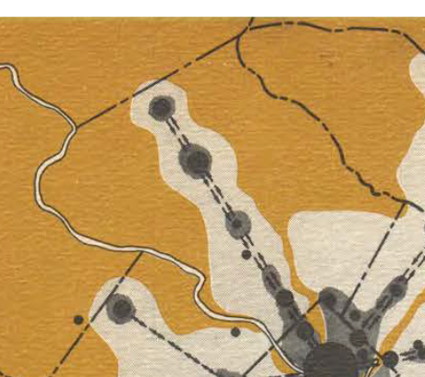
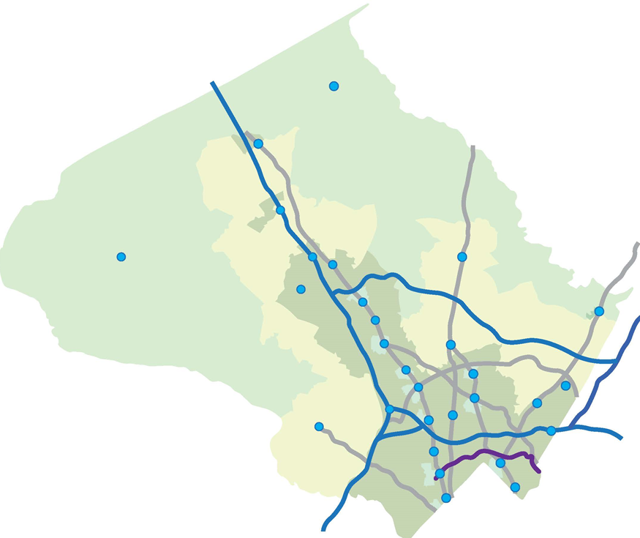
Introduction-Context-Rationale
Thrive Montgomery 2050 isn’t about reinvention. It’s about adapting to new realities and shifting the way we think about how the county should grow.
Economic Disruption
Technological Innovations
Regional + National Competition – Higher Living Cost – High Debt – Location Preferences
Artificial Intelligence – Autonomous Vehicles – Ride Sharing – Social Media – Online Retail
Social Change
Public Health – Social Isolation – Household Formation – Lifestyle Changes – Focus on Equity
Climate Change
Sea Level Rise – Extreme Temperatures – Extreme Weather Events – Habitat and Natural Resource Impacts – Infrastructure Cost – Energy
Demographic Shifts
Increasing Diversity – Smaller Family Size – Decreasing Birth Rates – Aging Population

Slide 4
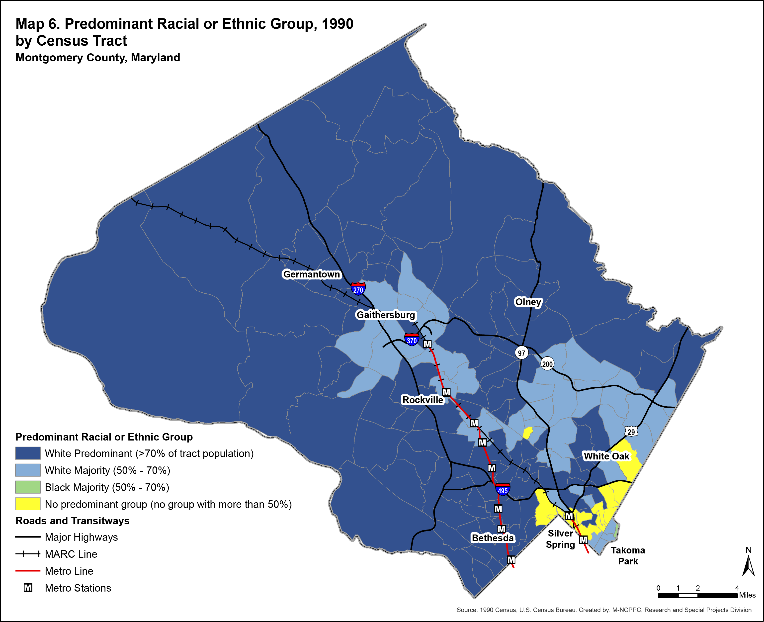
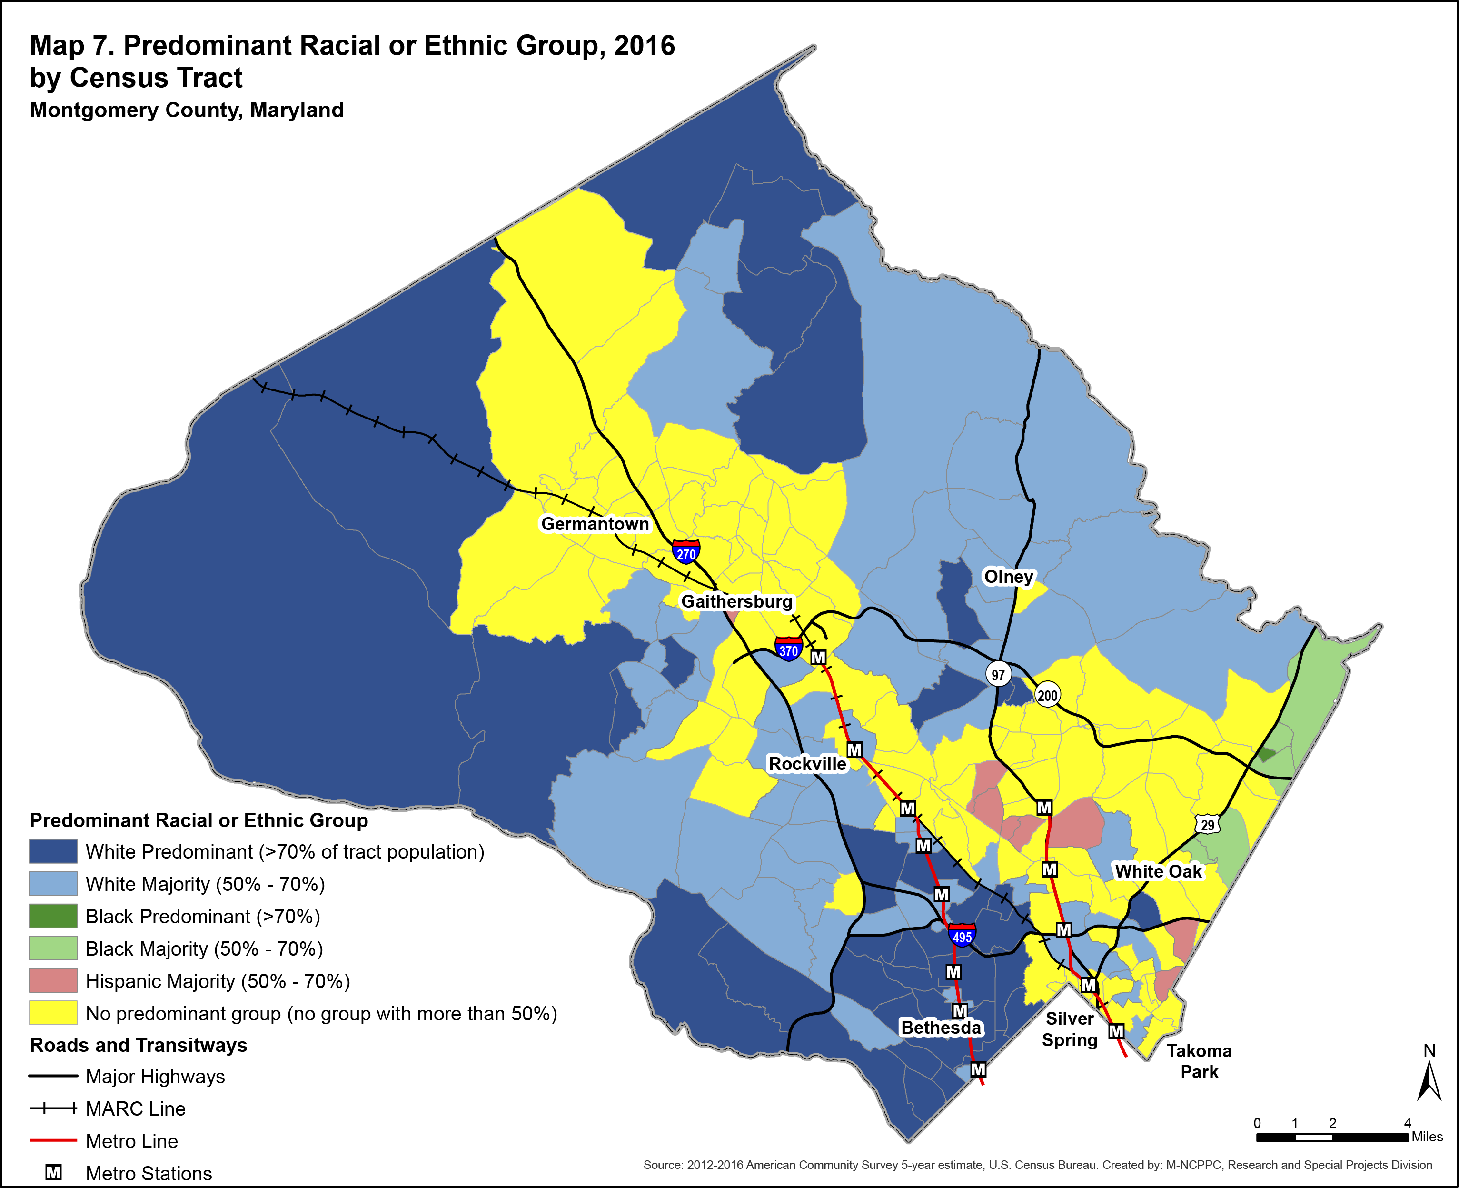
Change in County Demographics
Notes:
The dramatic change in Montgomery County’s racial and ethnic composition is well illustrated in 2 maps depicting the predominant racial or ethnic group in 1990 and 2016 at the U.S. Census tract level.
Predominant >70% of tract pop;
Majority 50-70%
No predominant group: no one group over 50% (yellow)
On left, Map 6 showing 1990:
In 1990, almost all tracts in Montgomery County were predominantly white comprising 70% or more of the population in each tract, or majority white with concentrations ranging from 50% to 70%.
Tracts in yellow where no one race or Hispanic group held more than half the population – i.e., no one group was predominant – were located inside the I-495 Beltway in parts of North Chevy Chase and Silver Spring, and in the Hillandale and White Oak areas.
>>>>>[SCROLL]
On right, Map 7 illustrates 2016:
With the increased diversity across the county by 2016, there was a broader array of racial and Hispanic concentrations with fewer predominant and majority white tracts.
Predominant and majority black or African-American tracts emerged along the Prince George’s County border and majority Hispanic tracts in Aspen Hill, Wheaton, Glenmont, and Silver Spring.
Evidence of diversity is seen in the increased number of tracts with no group comprising more than half the tract’s population.
A broad area of tracts with no predominant race or Hispanic group extends south from the Frederick County border encompassing Clarksburg, Germantown, Gaithersburg,
Zoom in down county:
parts of Rockville, and across the mid-county to the Prince George’s County border.
Zzzzzzzzzzzzzzzzzz
The dramatic change in Montgomery County’s racial and ethnic composition is well illustrated in 2 maps depicting the predominant racial or ethnic group in 1990 and 2016 at the U.S. Census tract level.
Explain definition of predominant & majority tracts
On left, Map 6 showing 1990:
In 1990, almost all tracts in Montgomery County were predominantly white comprising 70 percent or more of the population in each tract, or majority white with concentrations ranging from 50 percent to 70 percent.
- Tracts where no one race or Hispanic group held more than half the population – i.e., no one group was predominant – were located inside the I-495 Beltway in parts of North Chevy Chase and Silver Spring, and in the Hillandale and White Oak areas
On right, Map 7 illustrates 2016:
With the increased diversity across the county by 2016, there was a broader array of racial and Hispanic concentrations with fewer predominant and majority white tracts.
Predominant and majority black or African-American tracts emerged along the Prince George’s County border and majority Hispanic tracts in Aspen Hill, Wheaton, Glenmont, and Silver Spring.
Evidence of diversity is seen in the increased number of tracts with no group comprising more than half the tract’s population.
A broad area of tracts with no predominant race or Hispanic group extends south from the Frederick County border encompassing Clarksburg, Germantown, Gaithersburg, parts of Rockville, and across the mid-county to the Prince George’s County border.
Takoma Park joined the areas inside the Beltway that were already diverse in 1990
4

Slide 5
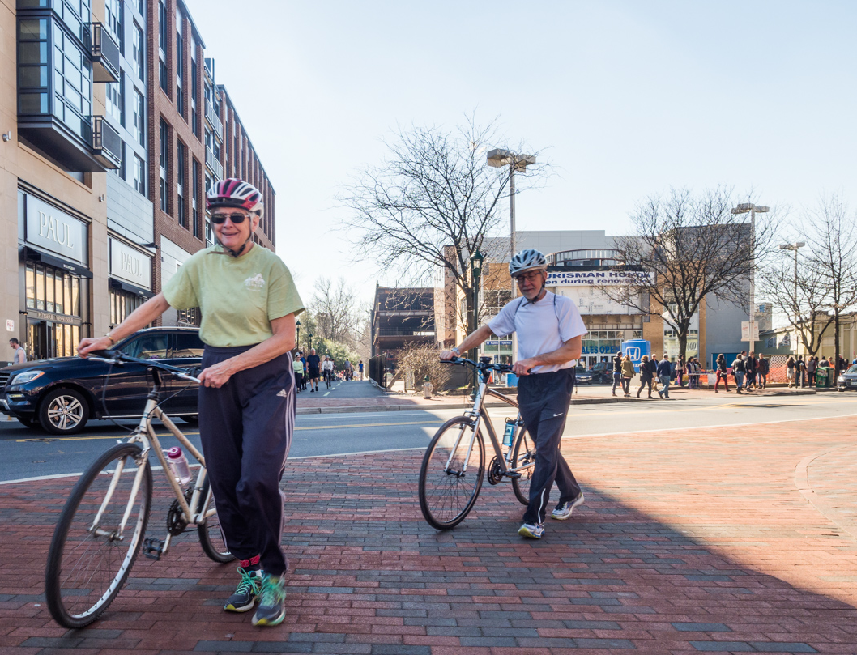
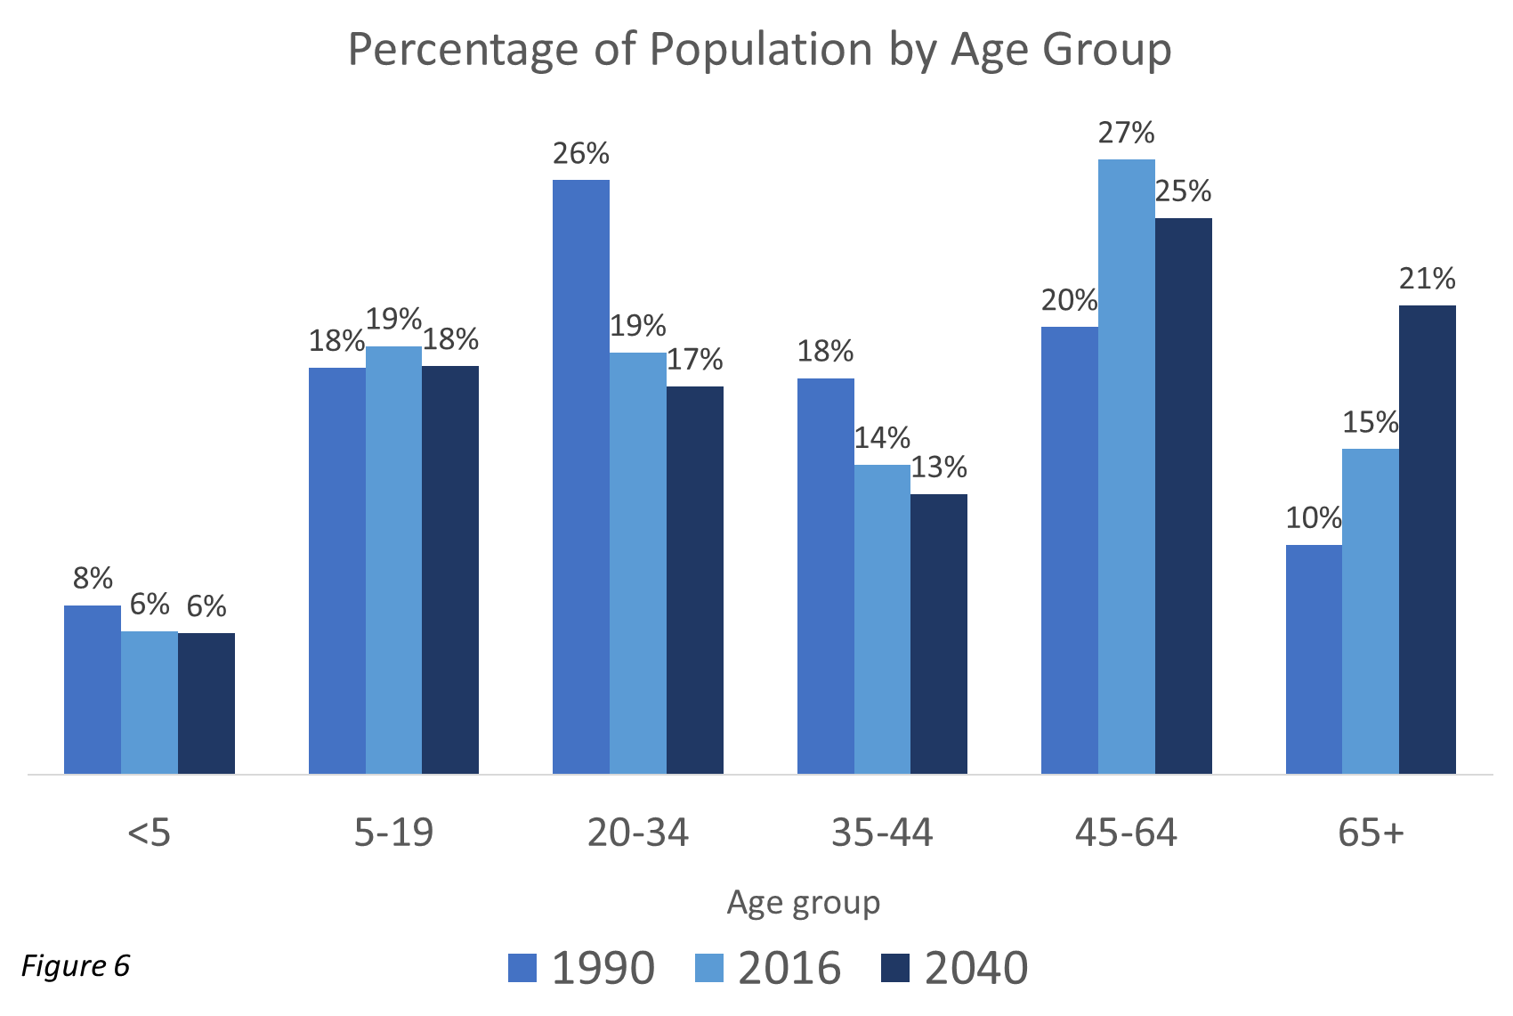
Increasingly Older Population
Notes:
GWEN
The aging baby boomers dominate any historical chart of age structure.
-In 1990 baby boomers were ages 26 to 44 and now are 52 to 70 in 2016.
-Maturing boomers increased the median age from 33.9 years in 1990 to 39 in 2016.
-Boomers are responsible for the forecasted increase in 65+ population from 15% in 2016 to 21% in 2040.
Two other cohorts of note:
-Millennials, young adult age 20 to 34 in 2016, are one out of five residents or about 191,000 people.
-Almost one-quarter of a million children under age 18 live in Montgomery County, making up 23 percent of the population.
The county gained about 66,000 children, up 27 percent since 1990.
The topic of age is further examined in the housing section and where it is strongly correlated with housing choice and tenure
ZZZZZZZZZZZZZZZZZZZZZ
The age distribution of Montgomery County residents, shown in Figure 9, noticeably shifted between 1990 and 2016 as the dominant baby boom generation, ages 26 to 44 in 1990, are now 52 to 70 in 2016. The median age of residents rose from 33.9 years in 1990 to 39 years in 2016 as the baby boomers matured.
About one out of five residents (191,171 people) is a young adult age 20 to 34 in 2016. The aging of baby boomers explains the percentage drop in the share of young adults, 20 to 34, from 26.5 percent in 1990 to 18.8 percent in 2016
Almost one-quarter of a million children under age 18 live in Montgomery County, making up 23 percent of the population. The county gained about 66,000 children, up 27 percent since 1990.
Influence of age structure is further examined in the housing section; strongly correlated with housing choice and tenure
5

Slide 6
Housing Growth Not Meeting Needs of Growing Population
Average since 1980: 4,300
Average since 2010: 2,700
Source: 1960-2010 US Census, 2016 American Community Survey, 1-year estimate, Census Bureau Building Permits

Slide 7
Other Trends and challenges
Sluggish economic growth
Racial/economic disparities
Neighborhoods largely separated along income and racial lines
Polarization—a lack of trust in government, civic institutions, and other social and ethnic groups; and fear of change
Challenges in public health and well-being
Climate change threatens all aspects of life

Slide 8
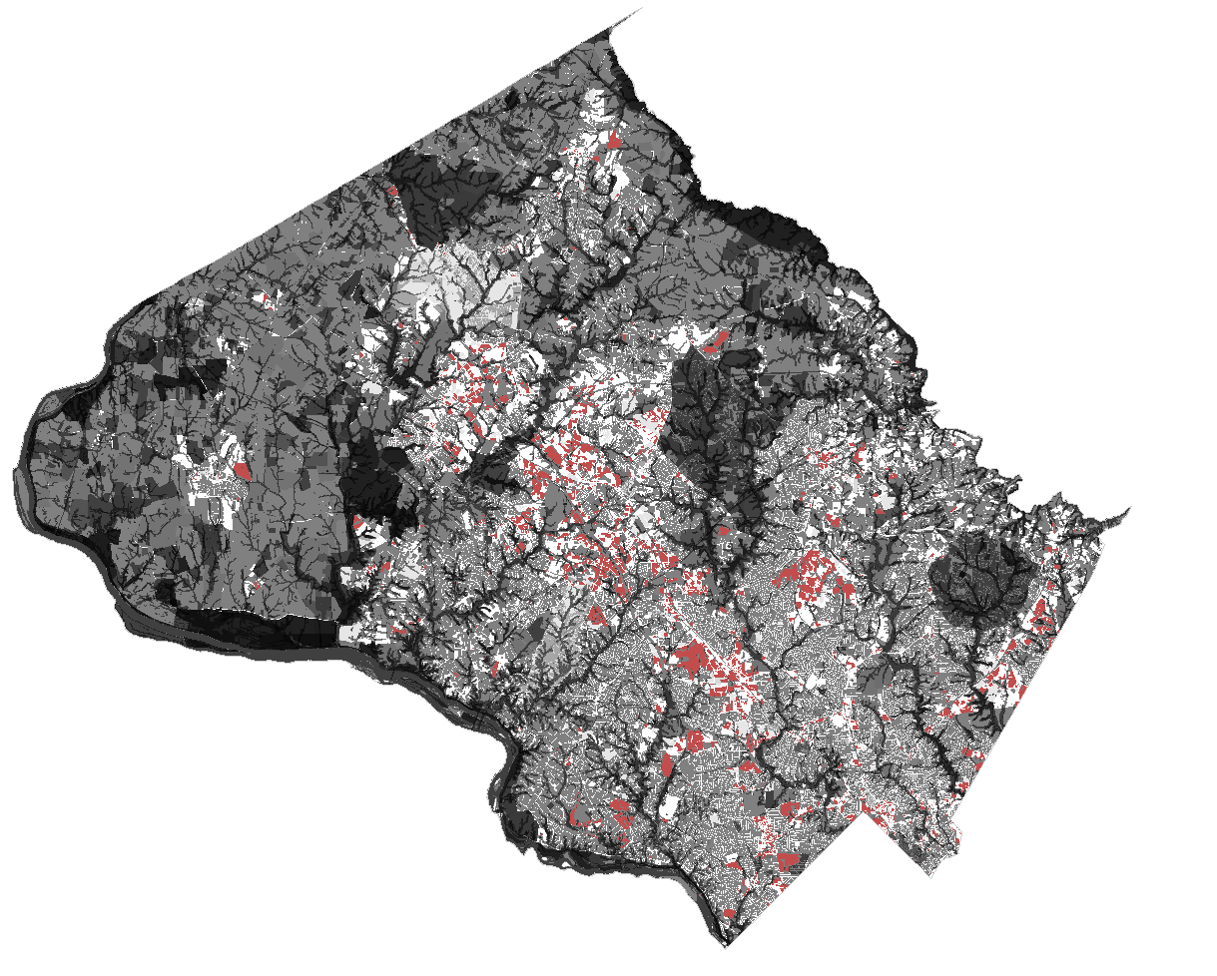

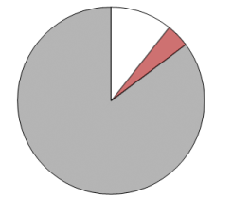
County is mostly built out
Man-made constraints
Utility Sites
  WSSC
  Transmission Lines
  Transportation Infrastructure
  Metro
  Rail
  State Roads
  Federal Highways
  Government Ownership
  Rustic Roads & Public Education
  Historic Preservation
  TDR Exhausted
  Rockville Quarry
  Regulated Affordable Housing,
  Private Institutional
  HOA Common Ownership
  Single Family Dwellings
Environmental constraints
Hydrological
  Streams
  Wetland Buffers
  Erodible soils
  Parks & Biodiversity areas
  Agricultural Reserves
  Special Protection Areas
  Forest Conservation Easements
Qualifiers
  Multiple owners
  Improvement Value >2 Land Value
  Office Buildings less than 50 years old
  Retail Buildings less than 15 years old
Constrained area = 276,515 Acres (85%)
Unconstrained area = 47,804 Acres (15%)
Notes:
Because Montgomery County is mostly built out in terms of available land—and we need to accommodate the projected new population growth—the way we think about growth needs to change. We need to think about growth happening on sites that we never thought of as possible for development. “Parking lots to places” is one important way of thinking about accommodating this growth, but we must also reexamine our other existing developments.

Slide 9
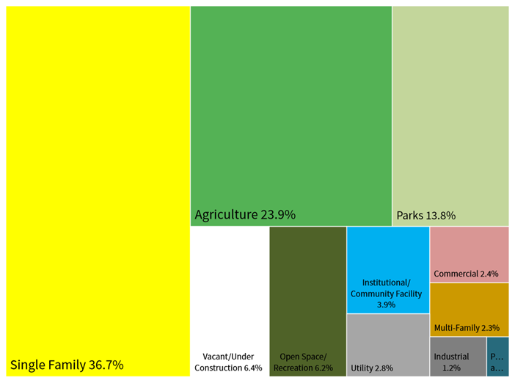
Current Land Use

Slide 10
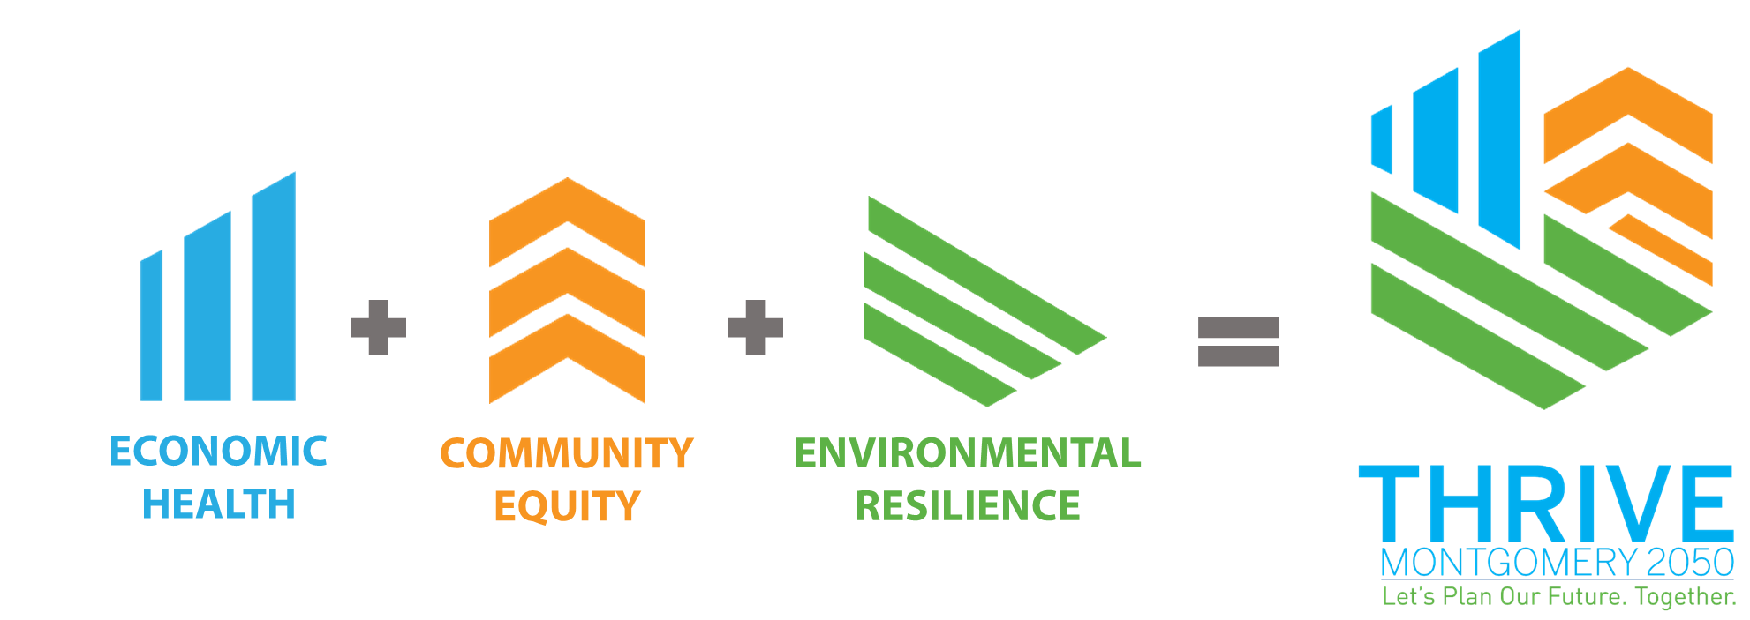
Planning Framework

Slide 11
Overall Vision
In 2050, Montgomery County is a web of complete communities connected by vibrant corridors.
Complete communities: Individual and unique neighborhood activity centers with a variety of housing types and price points located close to workplaces, needed goods and services, public amenities and open spaces.
Vibrant corridors: comfortable, safe corridors of multimodal transportation and services; and corridors of connecting green parks, stream valleys and trails.

Slide 12
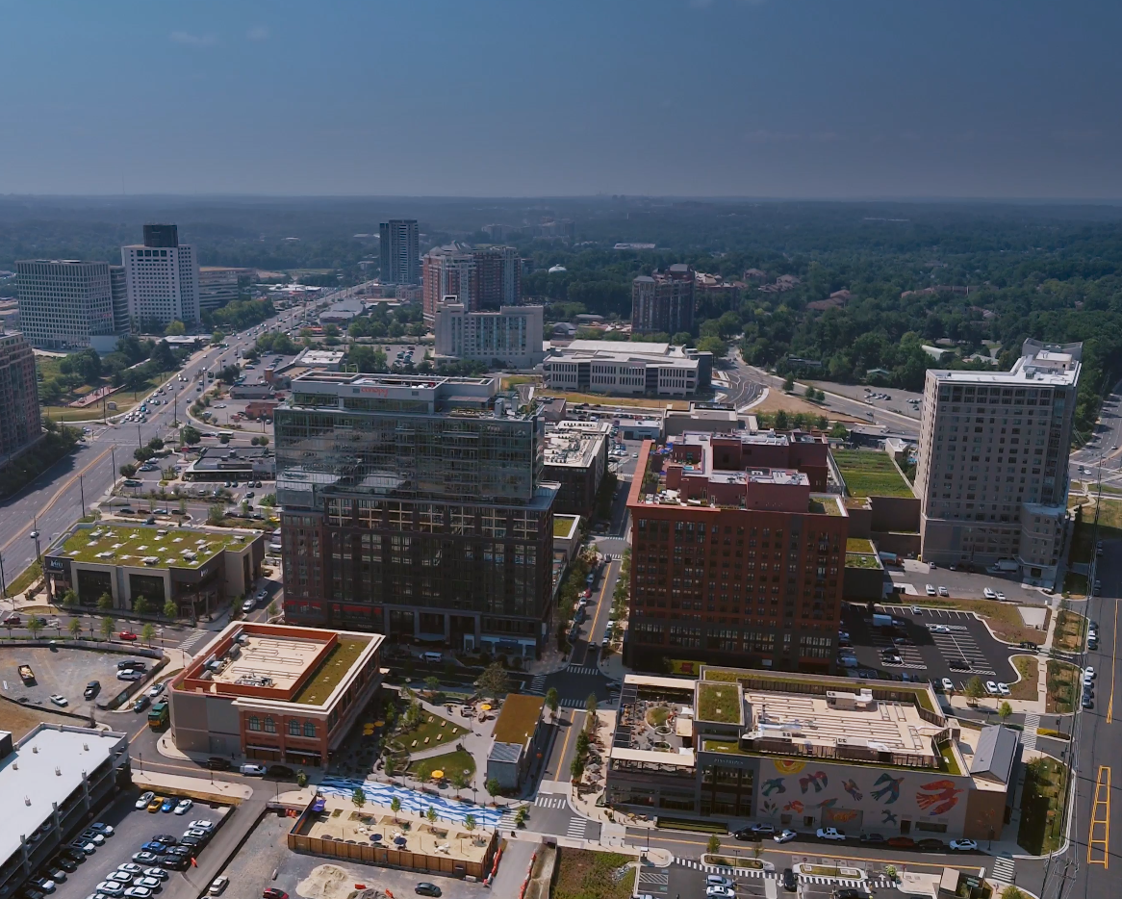
Key Themes
Compact Urbanism – transit corridors are the future
15-minute living
Active lifestyles for better health
Increased social interaction
Housing is a right and a value
Major roads transformed into boulevards
Stop planning for cars
De-pave the county
Varieties of commercial uses
Diversity is our strength
Embrace importance of place
Regional solutions to problems

Slide 13
A Guidebook, Not a Road Map
Laying out where we want to go, and what we don’t want to miss
High level recommendations to establish where we want to be in 30 years
Some Action items – “how to get there” – but not the complete route and itinerary

Slide 14
Next Steps
Issues Report
Presented to the Planning Board on February 27th
Draft Vision and Goals
Presented to the Planning Board on April 16th
We are here
Draft Vision, Goals, Policies and Actions
Planning Board presentation on June 11th
Working Draft Plan
September 2020
Planning Board Review + Transmittal
October 2020 – March 2021
Council Review + Approval
April 2021 - TBD
Notes:
KHALID

